Slide 1
STA 301H
Homework #1

Slide 2
Risk.csv

Slide 3
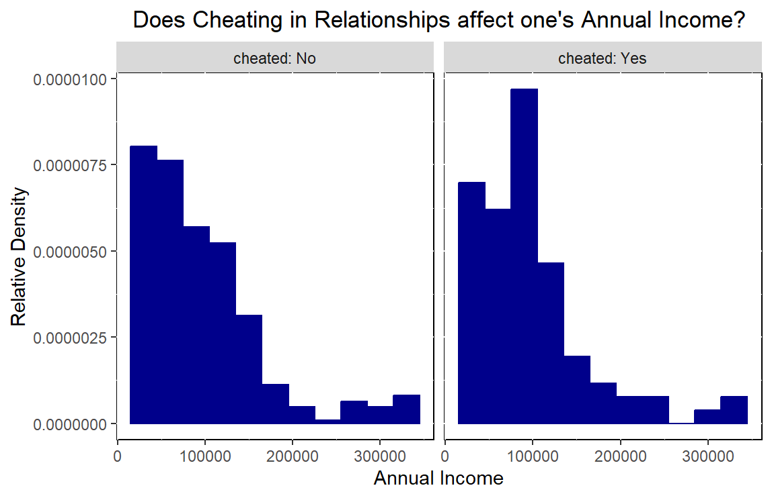
It appears that the fact that if someone has cheating in the past does not greatly affect one’s annual income as both graphs appear skewed to the right. The median salary for the cheating group is $84,439 while the median salary for the non-cheating group is $79,820. As a result, the fact that both graphs and median salaries are similar strengthen the argument that cheating does not correlate with income level.

Slide 4
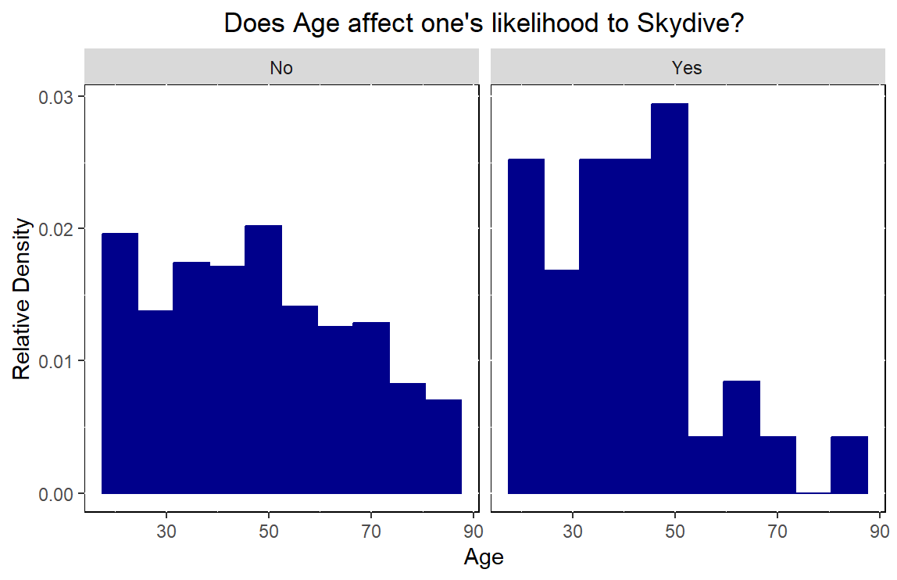
It appears that of the people who have skydived before, most of them are 50 years old or less. On the other hand, the distribution of people who have not skydived before is still right skewed, but more consistent over all ages. Of the total sample, 7% have skydived before.

Slide 5
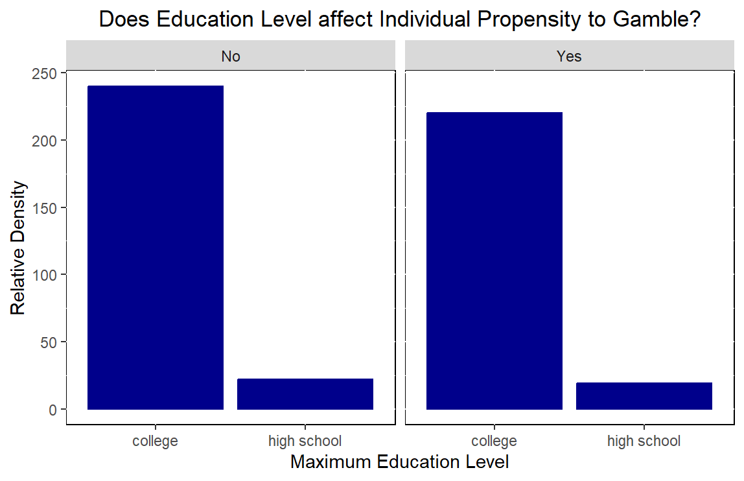
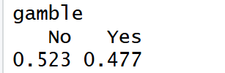
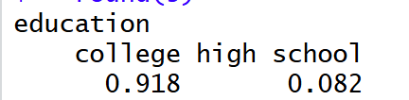
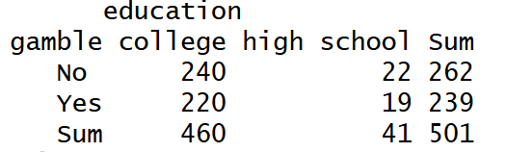
48% of people in the sample gamble while 8% only attended high school. 4% of the sample attended only high school and gamble. P(Gamble) = 48% which is approximately P(Gamble | High School). Therefore, the two events are nearly independent. Additionally, the bar plots show that regardless of whether one gambles or not, the maximum education level is relatively the same.

Slide 6
Candies.csv

Slide 7
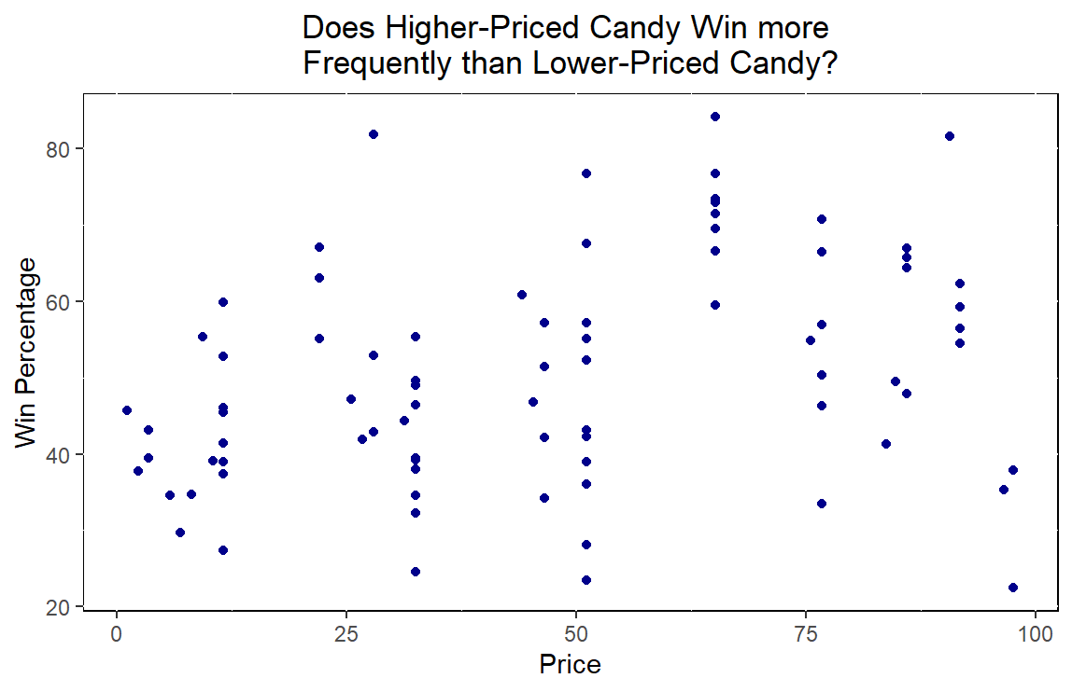
There appears to be no correlation between the price of a candy and the win percentage. Therefore, the price of a candy cannot be used to predict popularity.

Slide 8
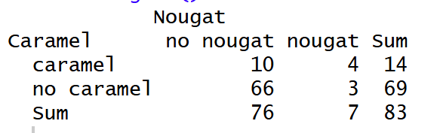
12% of candies contain both Nougat and Caramel while 80% contain neither. 57% of Nougat candies include Caramel as an ingredient and 4% of candies without Caramel contain Nougat as an ingredient.

Slide 9
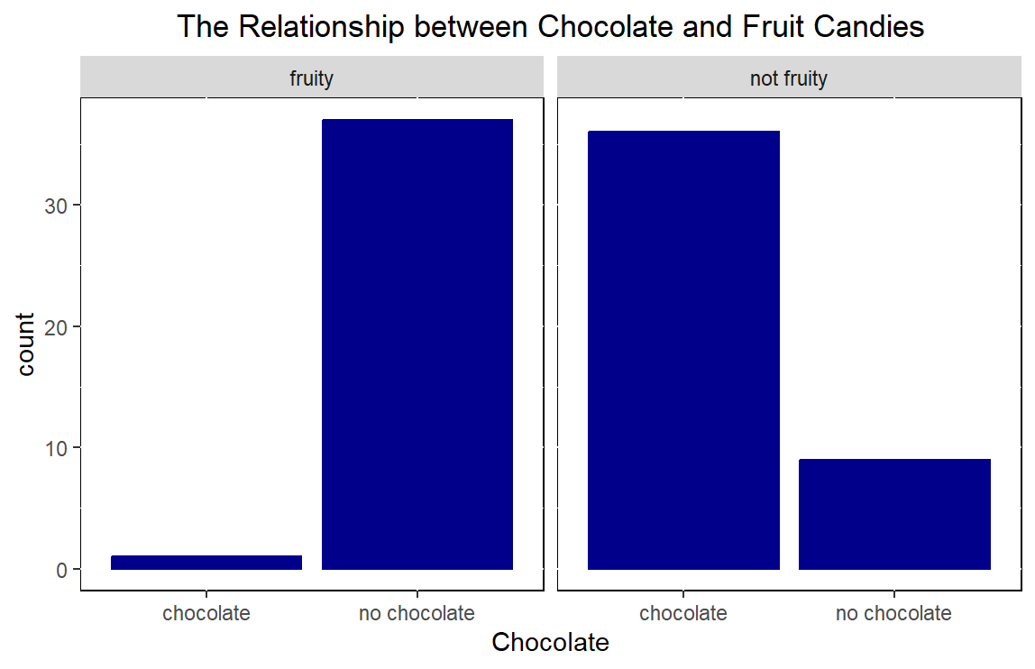
From the bar plot, it appears that most of the fruity candy do not contain chocolate while many non-fruity candies contain chocolate. Therefore, we can deduce that the two events occur highly dependent of each other.

Slide 10
superbowl.csv

Slide 11

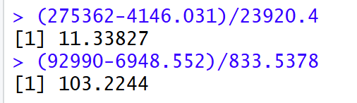
The Z-score for Sling Baby’s likes is 11 while the z-score for Sling Baby’s dislikes is 103. Therefore, the number of dislikes on Sling Baby is more extreme than the number of likes on the commercial.

Slide 12
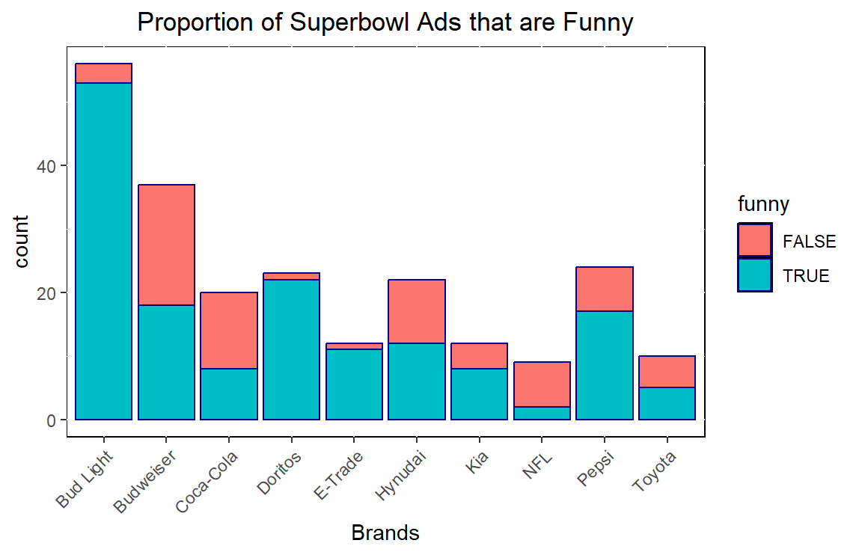
From the graph, it appears that many Superbowl commercials were funny, with Bud Light’s commercials having a large proportion of funny commercials. On the other hand, Coca-Cola, Budweiser, and NFL had a large proportion of commercials that were deemed not funny.

Slide 13
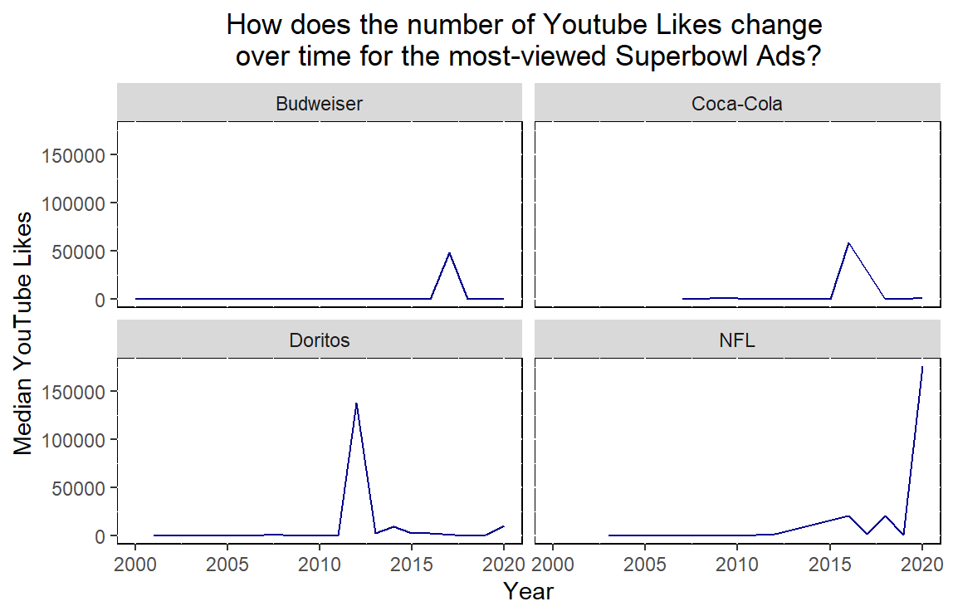
It seemed that for Budweiser, Coca-Cola, and Doritos, the trajectory was mostly constant with one spike. For the NFL, however, its trajectory seems to be increasing every year, with a large jump after 2020.

Slide 14
MSFT.csv

Slide 15
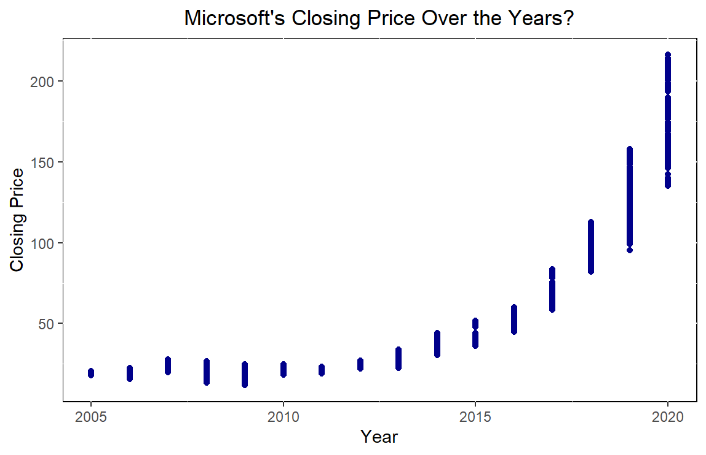
The data frame I chose shows Microsoft’s closing price on the stock market every day from 2005 to 2020. It appears that as time went on, Microsoft’s stock prices increased everyday, indicating their large-scale success in the technology world. The data frame can be found at this link.

